Slide 1
At the beginning of mathematical objects
JF Durand, M1, université Lille 1

Slide 2
Introduction
Do you have a problem with 27 ? (three times three)
No ? Well you are able to conceptualize (abstraction).

Slide 3
Plan
The Birth of equations
Formalization
Groups

Slide 4
The birth of Equations
This object called : unknown in mathematics has appeared for the first time in the Antiquity.
The problem was : « Division in Extrem and Mean Ratio »

Slide 5

The birth of Equations
The Goal is to divide a segment in two.
The little section divide by the tall section equals the tall section divide by the entiere segment.
A
B
A+B
$$\frac{B}{A}=\frac{A}{A+B}$$

Slide 6
The birth of Equations
Others problems talking about area.
Egyptian : A number and its sevenths equals nineteen. What is this number ?
Greek : Thales, Euclide, Pythagore
Solving methods are geometrical or numerical and always about lenght, area or volume.

Slide 7
Formalization
In the ninth century, Al Khwarizmy invent two object :
Unknown
Equation
He still uses sentences but gave up the thing behind the number (length, area, volumes… etc)
Now we can study equations for themselves.

Slide 8
Formalization
In 1830, Galois created the concept of « group »
For solving equations of higher degree
Open the way to a lot of derived object : circle, division ring

Slide 9
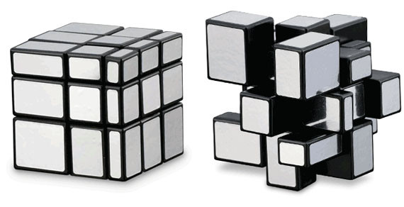
Groups
A group is a couple (G,S)
G a set : [a,b]
(number,variable,..etc)
S an operation : •
(+,-,*,/,..etc)

Slide 10
Groups
A group has to respect four rules :
Closure
a,b in G; • in G
Associativity
a,b,c in G: (a•b)•c = a•(b•c)
Identity Element (e)
e,a in G; e•a = a•e = a
Inverse Element
e,a,b in G; a•b = b•a = e

Slide 11
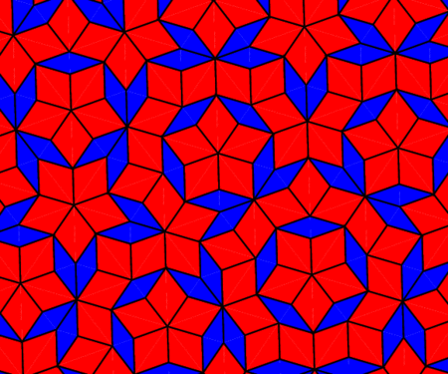

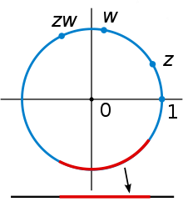
Groups
In practice
Ammonia, group of order 6
Trigonometric circle with multiplication is an usual group
17 regular paving like this one in the plane

Slide 12
Conclusion
Mathematics are universal ?
« Mathematics should be an obviousness for everyone, because it’s only a logical concatenation, which is in theroy a formality of the ‘common sense’ shared by everybody » Poincaré

Slide 13
Bibliography
Podcast Science
R. Herz-Fischler, A Mathematical History of Division in Extreme and Mean Ratio, Wilfrid Laurier.
https://fr.wikipedia.org/wiki/Al-Khw%C3%A2rizm%C3%AE
https://fr.wikipedia.org/wiki/Groupe_(math%C3%A9matiques)
http://images.math.cnrs.fr/Un-concept-mathematique-trois.html

Slide 14
Complex Number
Tartaglia find a way to solve 3 degrees of equations
Sometimes in the middle of the calculation he falls of a monster.
A monster is a square root of a negative number.
These numbers are called imaginary numbers.

Slide 15
Complexe Number
Later D’Alembert found that these monster is a multiple of a number that mulitply -1.
Written a+ib
Complexe is not the meaning of difficulty here, but the fact of their composition in two member.

